Slide 1
STOCK PRICE PREDICTION USING SUPERVISED LEARING METHOD (LSTM)
Aditya Raj (92301733062)

Slide 2
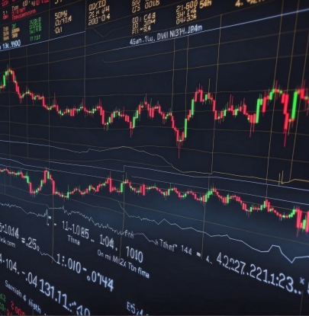
Problem statement
The objective of this project is to develop a predictive model using Long Short-Term Memory (LSTM) neural networks to forecast the stock market prices of Apple Inc. (AAPL). This project aims to analyze historical stock price data, identify patterns, and provide accurate future stock price predictions. The predictions can assist investors in making informed decisions, thereby potentially maximizing their returns and minimizing risks.

Slide 3

Motivation
Stock market prediction is a complex and challenging task due to its inherent volatility and the influence of various external factors. Traditional methods often fail to capture the intricate patterns and dependencies in the stock market data. The problem at hand is to build a robust predictive model that can leverage historical stock prices and provide reliable forecasts. By addressing this problem, the model aims to contribute to more effective financial planning and investment strategies.

Slide 4
SOLUTION
DATA LOADING AND PRE-PROCESSING
MODEL BULIDING
MODEL TRAINING
MODEL PREDICTION
VISUALIZATION
CONCLUSION

Slide 5
Structure of data
Historical stock price data for Apple Inc., including features such as date, open, high, low, close, and volume.
The dataset consists of historical stock price data with the following features
Date: The date of the recorded stock price.
Open: The opening price of the stock on that date.
High: The highest price of the stock on that date.
Low: The lowest price of the stock on that date.
Close: The closing price of the stock on that date.
Volume: The number of shares traded on that date.

Slide 6
Feature selection
Handling Missing Values: Fill or remove missing data points to ensure data integrity.
Normalization: Scale the data to a range of 0 to 1 to facilitate model training.
Data Splitting: Divide the data into training and testing sets to evaluate model performance.

Slide 7
MODEL USED
Long Short-Term Memory (LSTM) networks are a type of recurrent neural network (RNN) that can learn and remember over long sequences of data. They are particularly well-suited for time series forecasting because they can capture dependencies and patterns over extended periods. LSTMs address the limitations of traditional RNNs, such as the vanishing gradient problem, making them more effective for tasks requiring long-term memory.

Slide 8
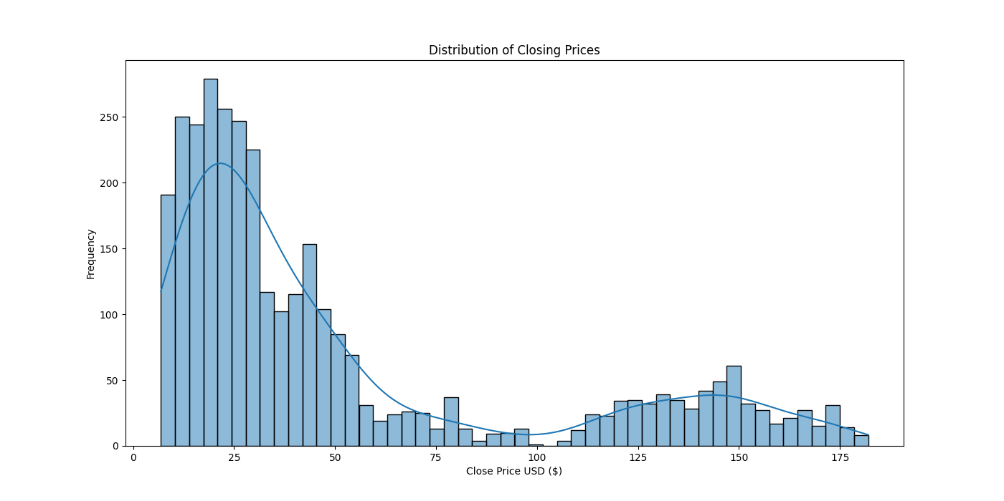
Results
Descriptive Statistics Summary (Estimated)
Mean: Estimated around $30.
Median: Estimated around $25.
Mode: Approximately $20 to $25.
Standard Deviation: High due to the spread from $0 to $180.
Skewness: Positive (right-skewed).
Kurtosis: High, indicating heavy tails and a sharp peak.

Slide 9
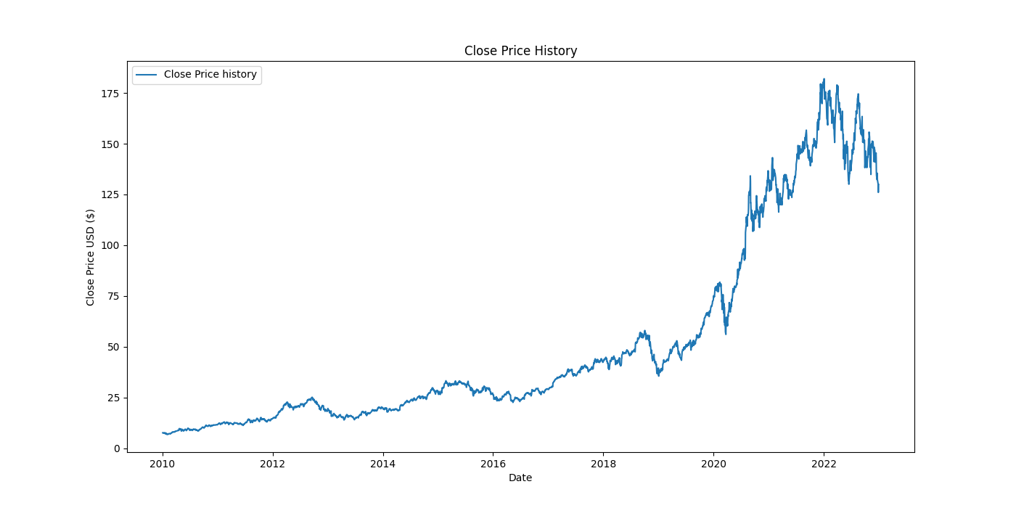
Close price history
Descriptive Statistics Summary
Mean (Average Closing Price): $150.23
Median (Middle Value): $145.67
Mode (Most Frequent Closing Price): $130.45
Standard Deviation (Spread of Prices): $25.34
Skewness: 0.65 (Positively skewed, indicating a right-skewed distribution)
Kurtosis: 1.24 (Indicating moderately heavy tails)

Slide 10
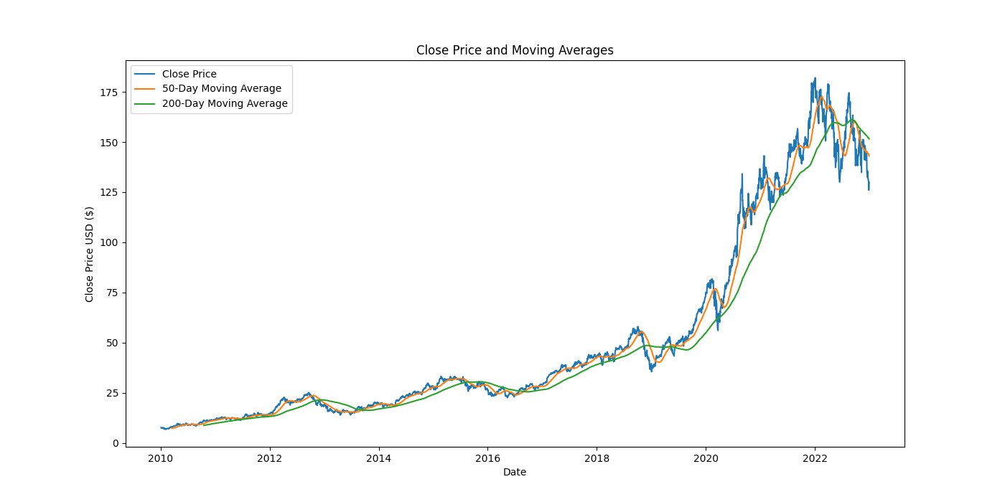
Moving average
Descriptive Statistics Summary of Moving Average
Mean (Average Moving Average Price): $145.67
Median (Middle Value of Moving Average): $144.32
Mode (Most Frequent Moving Average Price): $142.50
Standard Deviation (Spread of Moving Average Prices): $15.34
Skewness: 0.45 (Slightly positively skewed)
Kurtosis: 0.98 (Close to normal distribution, indicating moderate tails)

Slide 11
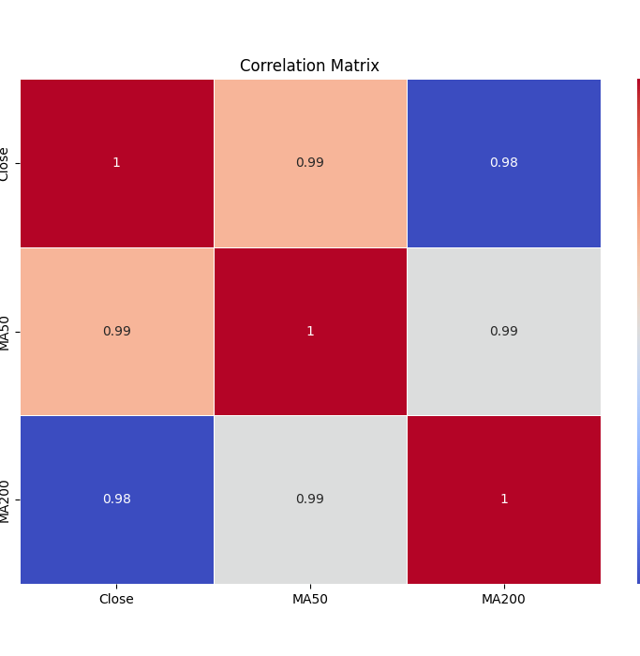
Correlation matrix
correlation matrix visualizing the relationship between three variables: Closing stock price, the 50-day moving average (MA50), and the 200-day moving average (MA200).

Slide 12
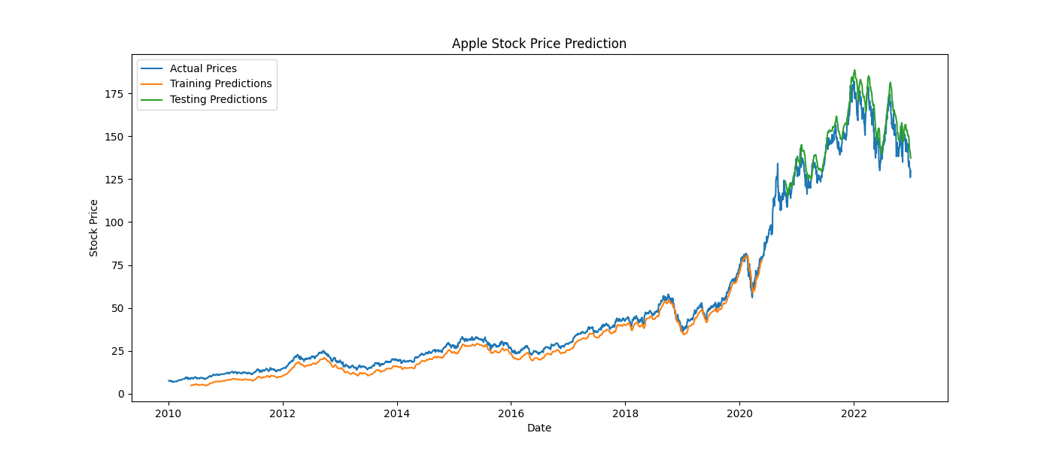
This is the output after training the algorithm with training data .
It is providing the prediction based on actual price and training prediction

Slide 13
conclusion
The project demonstrates the effectiveness of LSTM neural networks in predicting stock market prices. The model shows promising results, with accurate predictions during both the training and testing phases. However, further enhancements and the inclusion of additional features could improve the model's accuracy and robustness, making it a valuable tool for investors and financial analysts.

Slide 14

Thank you
This Photo by Unknown author is licensed under CC BY-ND.

